Slide 1
There are two networks in the company

Slide 2
There are two networks in the company
LAN – local area network

Slide 3
There are two networks in the company
LAN – local area network
WAN – world area network

Slide 4
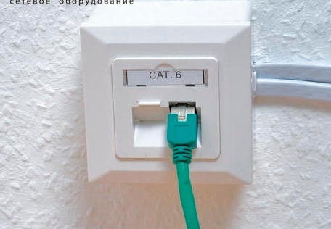
Working process
For switch the network uses a network socket
One network is for the inner recourses and programs, the other is available for the Internet. It made for the security, that no one from the outside can’t reach to secret information
Each of them uses switches – special network devices, which connect all computer in the net.
This is the device that my work is associated with.

Slide 5
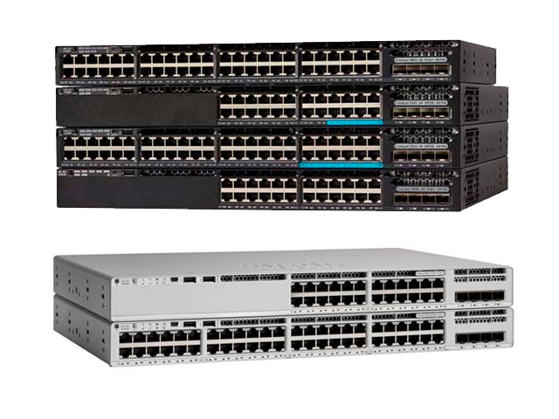
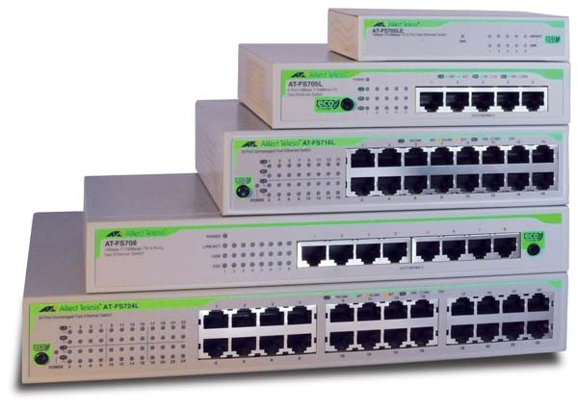
Swithes
There are two types of them: managed and unmanaged switch.
Unmanaged, that just connect computers, no can be done with them.
The managed ones have some functions. For example, turn off the one of the ports, we can see which IP address on which port.
Managed swithces
Unmanaged swithces

Slide 6

Swithes
I will not go into details, believe me, if a problem occurs in the network, then it can be solved much easier, having a managed switch.
Managed swithces
Unmanaged swithces

Slide 7
Returning to our two networks in the factory.
The one that looks at the Internet consists of unmanaged switches. Previously, this was possible, since there were few computers with the Internet, it was easy to control them. Now there are about 500. Problems have begun to arise often, it is more difficult to solve.
Managed
LAN – local area network
WAN – world area network
Unmanaged

Slide 8
Based on the above, we can set a task and define a goal.
The task: fill the network for Internet with managed switches.
Goal: to solve the problems in the Internet network faster.

